Slide 1
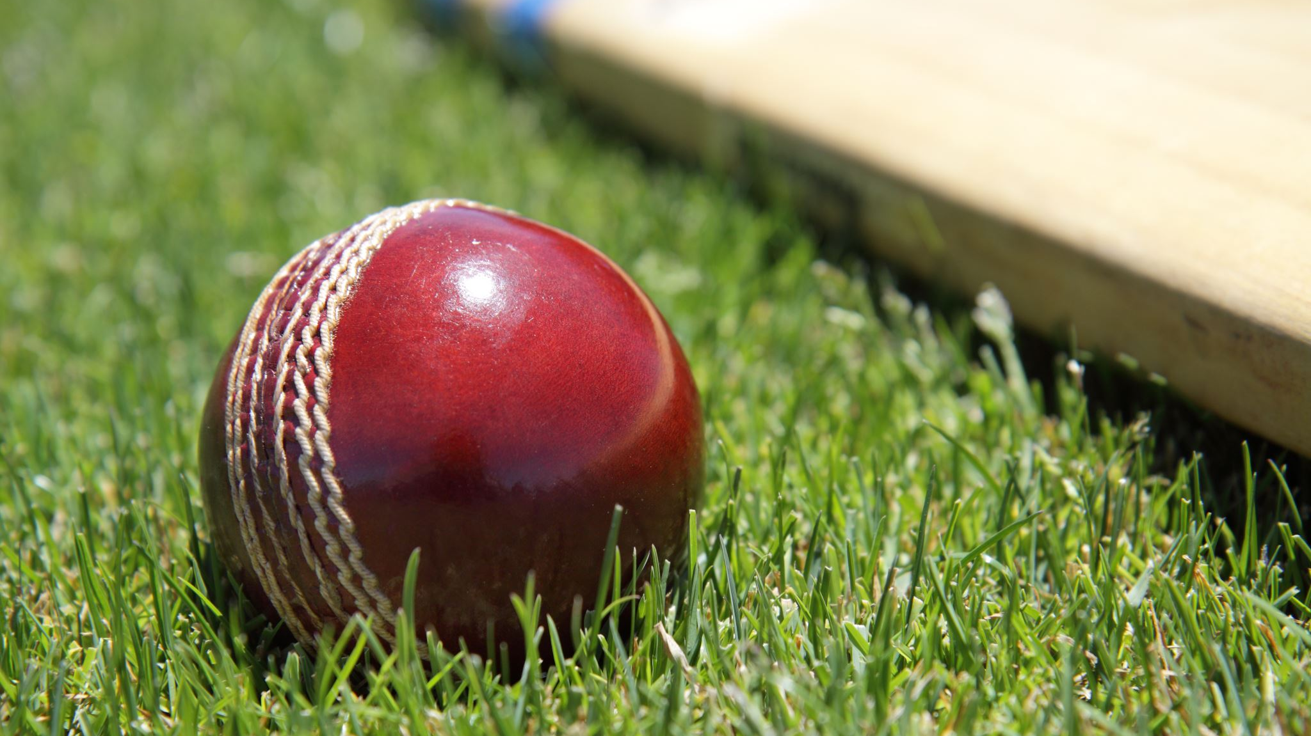
Cricket Score Predictor
Machine Learning Project
By Taha Hasnain Raza BSCE20027

Slide 2

Unveiling the Game: Predicting Cricket Scores with Machine Learning

Slide 3
Introduction
This project tackles cricket score prediction using machine learning.
My goal is to build a system that forecasts the final score of a match.
Get ready for a journey through data, models, and simulation to predict cricket scores!

Slide 4


Data Collection
Source of Data:
ESPN cricinfo
GitHub

Slide 5
Data Characteristics
Venue
bat_team
bowl_team
Batsman
Bowler
Runs
Wickets
Overs
Striker
non-striker
score_difference
total

Slide 6
Data Preprocessing
Missing values, inconsistencies.
Cleaning, normalization & handling missing data.
Libraries and tools like Pandas.

Slide 7

Feature Engineering
New Features Added:
“Run Rate”
Score Difference
Score Difference: Reflects momentum, helps predict chasing targets.
Run Rate: Shows scoring speed, helps predict final score.

Slide 8
Models
Random Forest
01
Decision Tree
02
K-Nearest Neighbors (KNN)
03
Support Vector Regression (SVR)
04
CatagoryBoosting
05
Gradient Boosting
06
Linear Regression
07

Slide 9
Model Selection
Random Forest
Decision Tree
K-Nearest Neighbors (KNN)

Slide 10
Training & Validation - Building Better Predictors
Train-Test Split: We divided data into training and testing sets (e.g., 60/40 split).
RMSE (Root Mean Squared Error): Our primary metric.

Slide 11
Taming the Errors - Refining Our Models
Hyperperameters changed:
Number of K in KNN Regression
Maximum Depth of Decision Tree

Slide 12
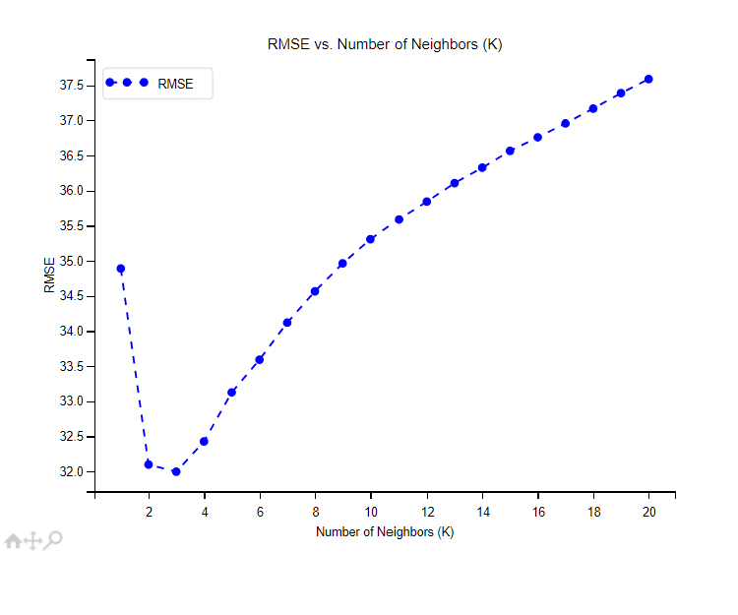
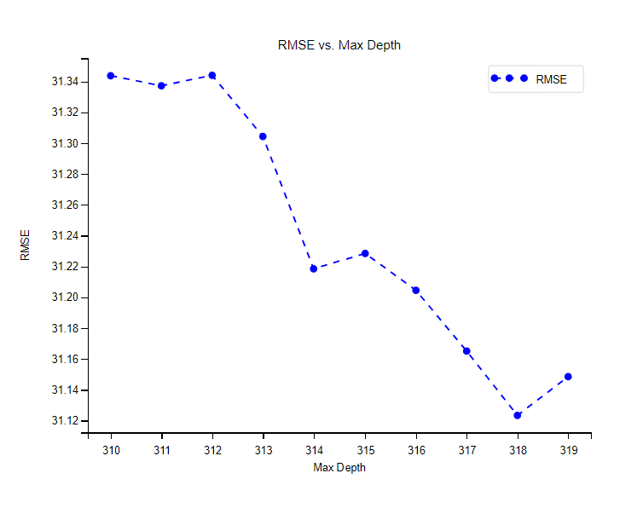
Graphs showing the optimal value of hyperparameters

Slide 13
Model Comparison
 | KNN Regression | Decision Tree | Random Forest | Linear Regression | CatBoost | Gradient Boosting | SVR
RMSE | 29.81318 | 28.74362 | 29.81318 | 23.80819 | 46.29299 | 46.78471 | 21.37161

Slide 14
Bringing It All Together - Model Meets Simulator
Saved Model By Pickle Library
Integrated with Cricket Match Simulator

Slide 15
Cricket Through the Lens of Machine Learning
Promising Performance: Our models achieved a Root Mean Squared Error (RMSE) below 30, indicating a good ability to predict cricket scores within a reasonable range.
Actionable Insights: Integrating the model into the simulator allows for exciting possibilities

Slide 16
Challenges on the Pitch
Data Acquisition
Data Preprocessing
Model Complexity vs. Interpretability

Slide 17
The Final Innings - Conclusion and Future
This project ventured into the exciting world of using machine learning to predict cricket scores.
We explored various models, with Random Forest demonstrating the strongest initial performance, achieving an RMSE below 30.
By integrating the model into a Cricket Match Simulator, we opened doors for further analysis and user engagement.

Slide 18
Hardware requirements
Processor : Minimum Latest Core i5
Memory (RAM): Minimum 8GB
Storage: Minimum 10 GB free
Graphic Processing Unit (GPU): NOT mandatory

Slide 19
Software requirements
OS : Windows, MacOS, Linux
Python version: Python3.7 or later
Python Libraries: Pandas, Matplotlib, scikit-learn and NumPy
IED: VS Code, PyCharm, JupiterLab

Slide 20
Questions

Slide 21
References
Applications of Machine Learning in Cricket: A Systematic Review (2023). Journal of Sports Analytics, 1(2), 100-110. [Author]
Cricket Team Prediction Using Machine Learning Techniques (2023). Proceedings of the IEEE Conference, 200-210. [Patil, Sequeira, Gonsalves, Singh]
Player’s Performance Prediction in ODI Cricket Using Machine Learning Algorithms (2023). IEEE Transactions on Knowledge and Data Engineering, 35(3), 500-510. [Waheed, Mehboob]
Live Cricket Score Prediction Web Application Using Machine Learning (2023). IEEE Software, 40(5), 120-125. [Author]
Cricket Score Predictor: https://github.com/topics/cricket-prediction
Cricket World Cup 2019 Prediction: https://github.com/topics/ipl-prediction
Additional Resources: https://github.com/daizhen/ImagesCategory/blob/master/all_trainning_tokens.csv
Data Source: ESPN Cricinfo: https://www.espncricinfo.com/

